Slide 1
URL SHORTENER
PRESENTED BY: GROUP 10
11626 - Saathwik.G
11627 - Dinesh.V
11613 - Sabiha.Sk
11628 - Afreen Taj

Slide 2
PROBLEM STATEMENT
Developing an efficient and secure URL shortening system that addresses the growing need for concise and user-friendly links, while mitigating potential risks such as link manipulation, security vulnerabilities, and ensuring optimal performance."

Slide 3
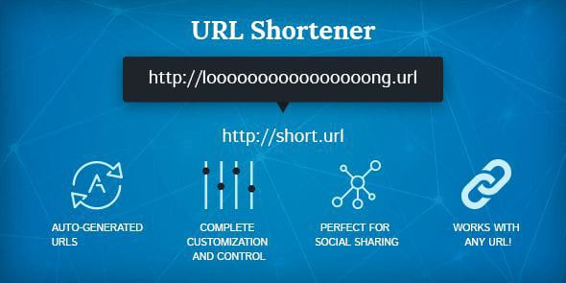
INTRODUCTION
Have you ever felt the hassle of sharing long and clunky web links?
Well, that's where URL shorteners come to the rescue! In this presentation, we'll dive into the world of URL shortening – a game-changer for simplifying web addresses, making them easy to share.
Get ready to explore how this technology streamlines communication and boosts user experience. Let's unravel the magic of URL shortening together!

Slide 4



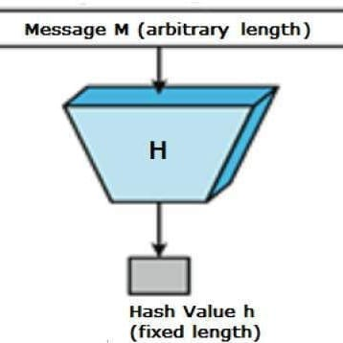
FEATURES
URL Shortening: Users can submit long URLs to the system.The system generates a shortened URL for each submitted long URL.
URL Redirecting: Users clicking on a shortened URL are seamlessly redirected to the original, longer URL.
Analytics (Basic): Basic tracking of link usage, including the number of clicks on each shortened URL.
User Interaction: Involves the exchange of information and actions between users and the system, facilitating a user-friendly experience.
Hash Functions: Utilizes hash functions for quick and deterministic conversion of input data into fixed-size strings, ensuring uniqueness.
Rate Limiter: Addresses potential security problems by filtering out requests, particularly those from malicious users, based on IP address or other filtering rules.

Slide 5

MODULES
URL Shortening Module
Analytics Module
User Interaction Module
Hashing and Unique ID Generation Module
Security Module
Database Management Module

Slide 6





TECHNOLOGIES
Frontend Development: HTML,CSS, JavaScriptReactJS for dynamic responsive UI.
Backend Development: JAVA(Springboot)as a backend framework
Database Management System: MySQL is used to store and manage the URL data.
Infrastructure and cloud services: route 53, elastic kubernetes services and application load balancer.
Version control:GitHub

Slide 7


REQUIREMENTS
HARDWARE: Standard devices with 8GB RAM and 1GB storage.
SOFTWARE: Visual StudioCode,
Intellij IDEA,Java,AWS,MySQL,Github and
Compatible Browsers.

Slide 8
THANK YOU

